Slide 1

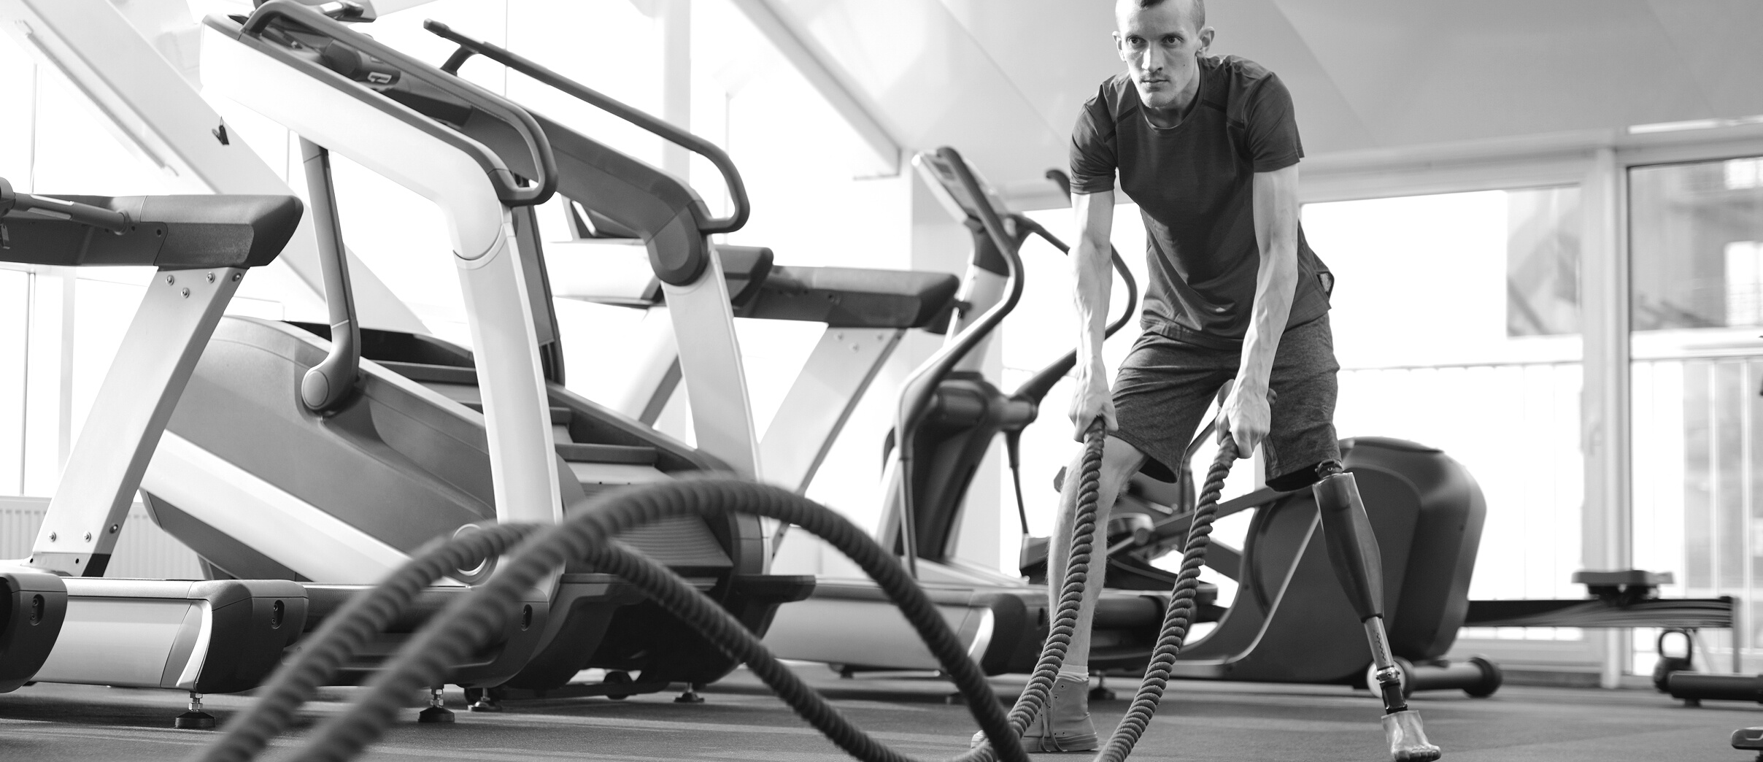


INSTRUCTOR:
PROF. SHRADDHA VYAS
PROF. SACHI JOSHI
DEPSTAR CE-1
GYM MANAGEMENT SYSTEM
GET FIT DON'T QUIT
TAKE CARE OF YOUR BODY. IT'S THE ONLY PLACE YOU LIVE
Presented By:
20DCE016 - KHUSHBU CHAUHAN
20DCE019 - YATHARTH CHAUHAN
20DCE024 - DEEP DHADUK
Notes:
f

Slide 2


F7
AGENDA
About Us
Introduction
Objective
About Project
Problem System
Limitation of Existing System
Features and Technology
Hardware and Software Specification
Flow Chart
Gantt Chart
References
Team Presentation

Slide 3
F7
INTRODUCTION
About Us
Objective of the Project
The main objective of the project is to design and develop a user friendly system.
Easy to use and efficient computerized system.
To develop an accurate and flexible system, it will eliminate data redundancy.
Computerization can be helpful as means of saving time & money.
To provide better graphical user interface.
Less chances of information leakage.
Provides security to data by using login & password.

Slide 4
F7
ABOUT PROJECT
About Us
Focuses mainly on dealing with the customer regarding their payments, routines, records.
Also, the system displays all the available data such as customer’s details with their respective payment amount, routines, and health status.
The project contains an Admin Panel. n an overview of this web app, the admin has access to register customers as well as maintain their payment records.
TalIking more about the project, the admin can create new plans for the customer’s payment.
In terms of health status, he/she has to update each and every customer’s profile with current weight, height, calories, fats, etc.
Besides, the admin can also manage exercise routines up to a week’s routine

Slide 5
F7
AN ADMIN SIDE
About Us
An admin can view overall reports of their members under monthly reports and yearly reports.
Also, he/she can view total income per month which displays the member’s name with id, gender, contact, payment date, expiry date, plan name, amount, and certain validity respectively.
Lastly, the system allows the admin to update the profile which includes username, full name, and the user can change their password information too.

Slide 6
F7
About Us
LIMITATION OF EXISTING SYSTEM
Time consumption: As the records are to be manually maintained it consumes a lot of time.
Paper work: Lot of paper work is involved as the records are maintained in the files & registers.
Storage requirements: As files and registers are used the storage space requirement is increased.
Less reliable: Use of papers for storing valuable data information is not at all reliable.
Accuracy: As the system is in manual there are lot many chances of human errors. These can cause errors in calculating mechanism or maintaining customer details.
Difficulty in keeping new records: It is difficult for keeping all the new entries of members, their account and transaction details.

Slide 7
F7
About Us
PROBLEM STATEMENT & IT’S SOLUTION
The gym is working manually. The current system is time consuming because registration process to add members. To manually handle the system was very difficult task. But now-a-days computerization made easy to work.
The following are the reasons why the current system should be computerized:
To increase efficiency with reduced cost.
To reduce the burden of paper work.
To save time management for recording details of each and every member and employee.
To generate required reports easily.

Slide 8
F7
Features and Technology
About Us
Features of our project:
Admin Panel
Customer Registration
Make Payments
Maintain Health Status
Create and manage plans
Overall reports
Manage routines
Technology used:
Fronted: HTML, CSS, JS, Bootstrap
Backend: phpMyAdmin, MySQL

Slide 9
F7
About Us
HARDWARE AND SOFTWARE SPECIFICATION
Hardware Requirements
Processor: 1.2 GHz or more
Ram: 1 GB or more
HardDisk: 2 GB or more
Software Requirements
Operating System: Windows XP, 7, 8, 10,11
Web Browser: Explorer, Firefox, Google Chrome
Language Used: HTML, CSS, JavaScript, PHP, PhpMyadmin, MYSQL, bootstrap.

Slide 10
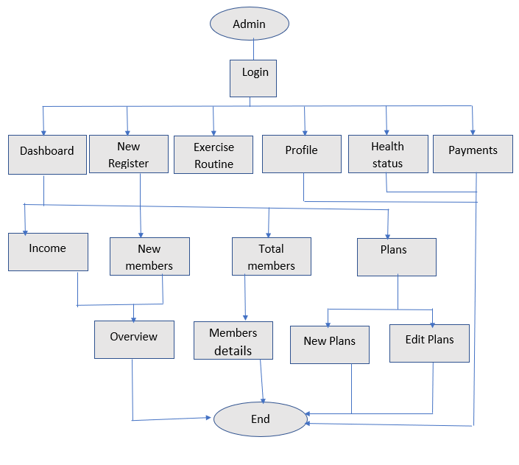
F7
About Us
FLOW CHART

Slide 11
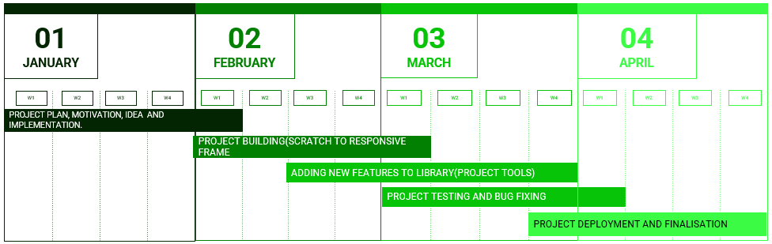
F7
About Us
GANTT CHART

Slide 12
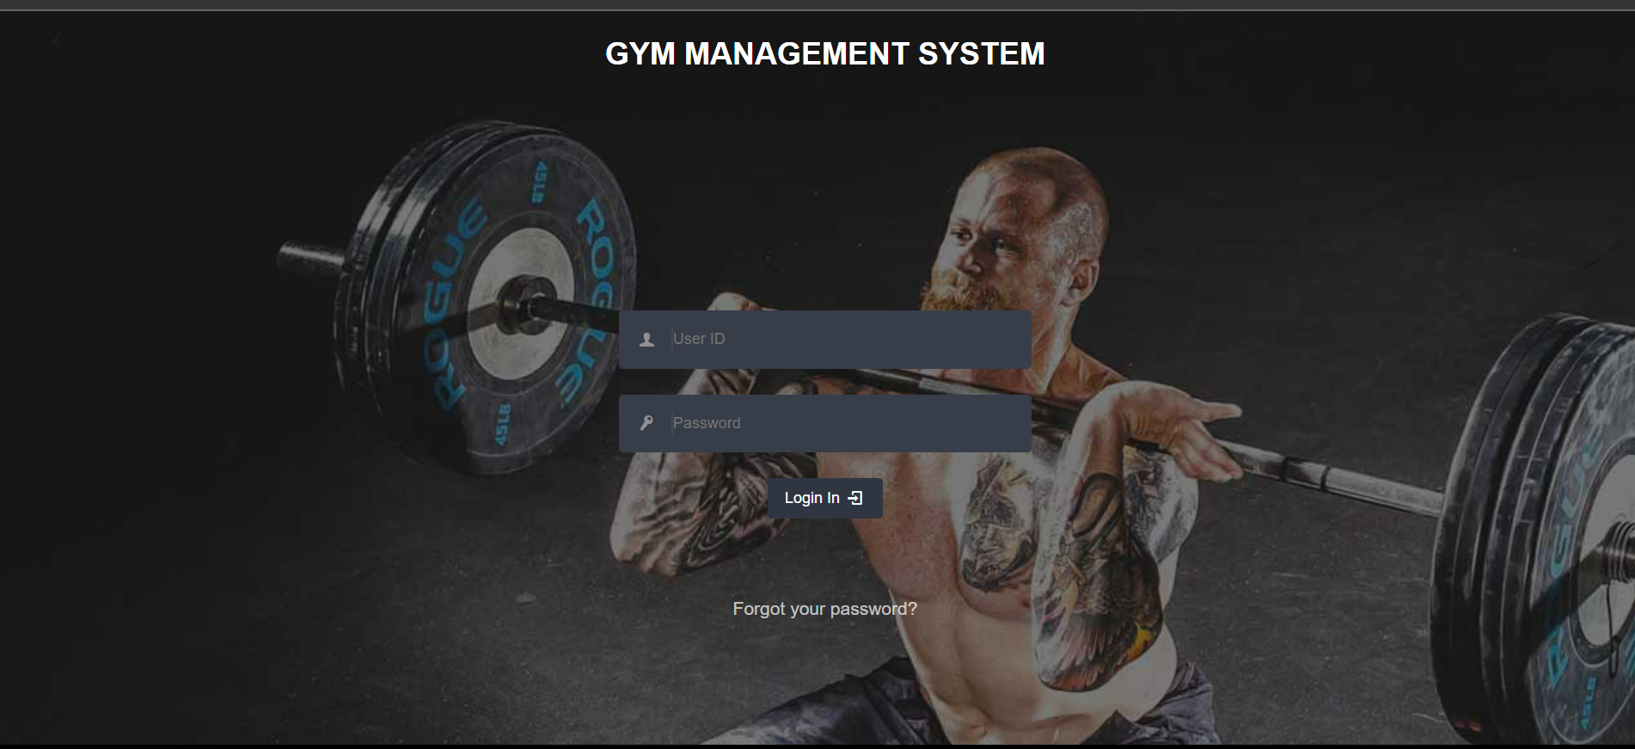
F7
Login Page
About Us

Slide 13
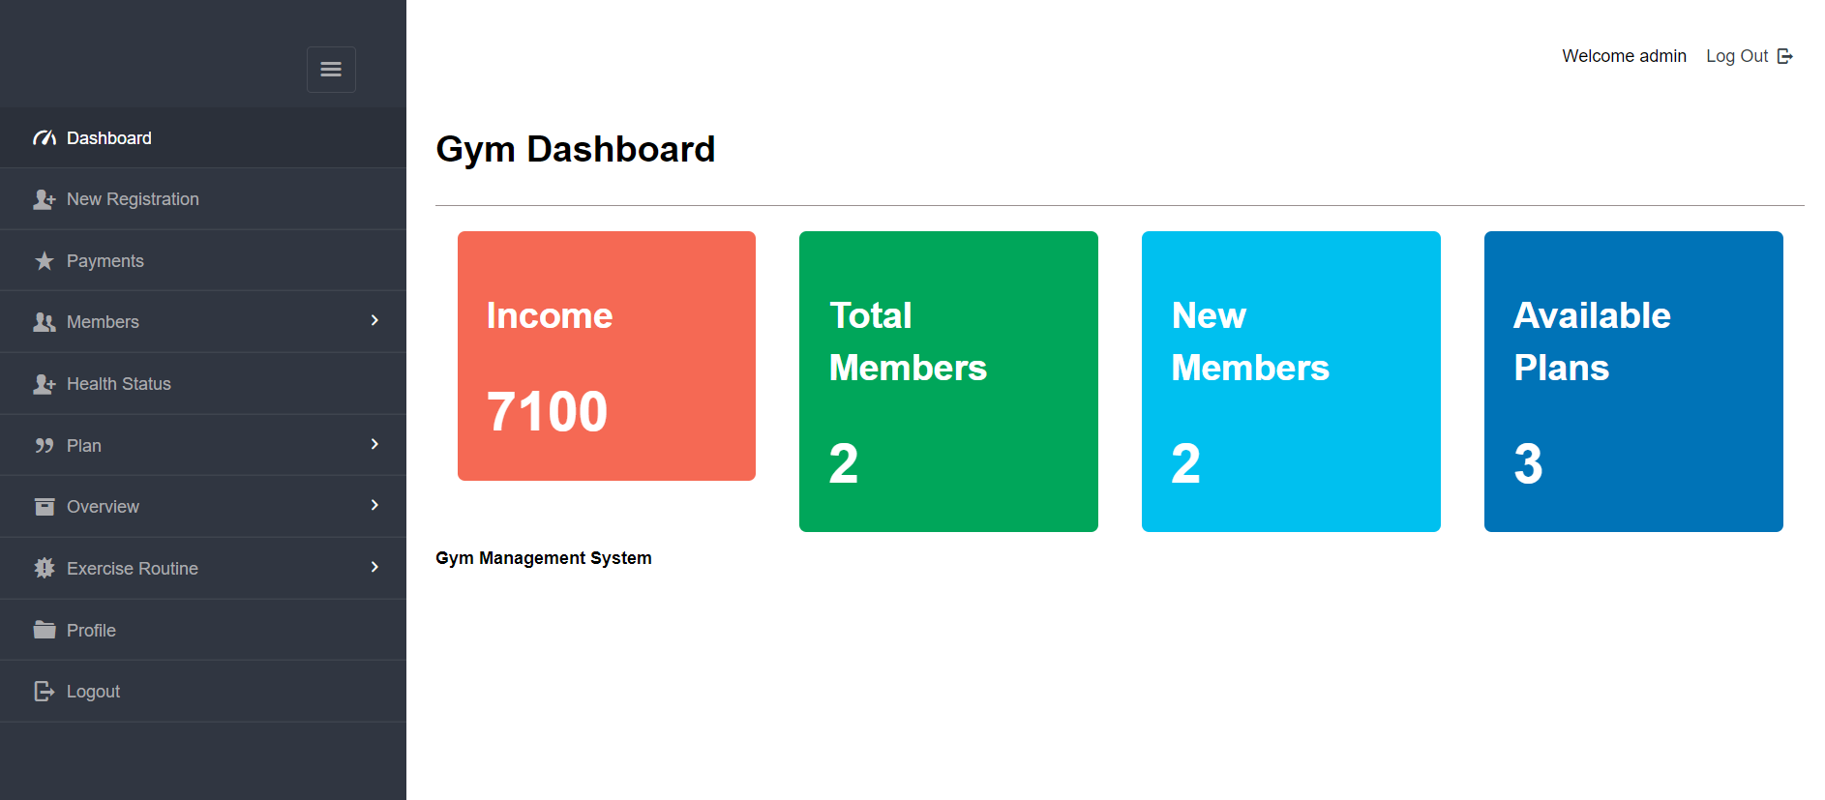
F7
Dashboard Page
About Us

Slide 14
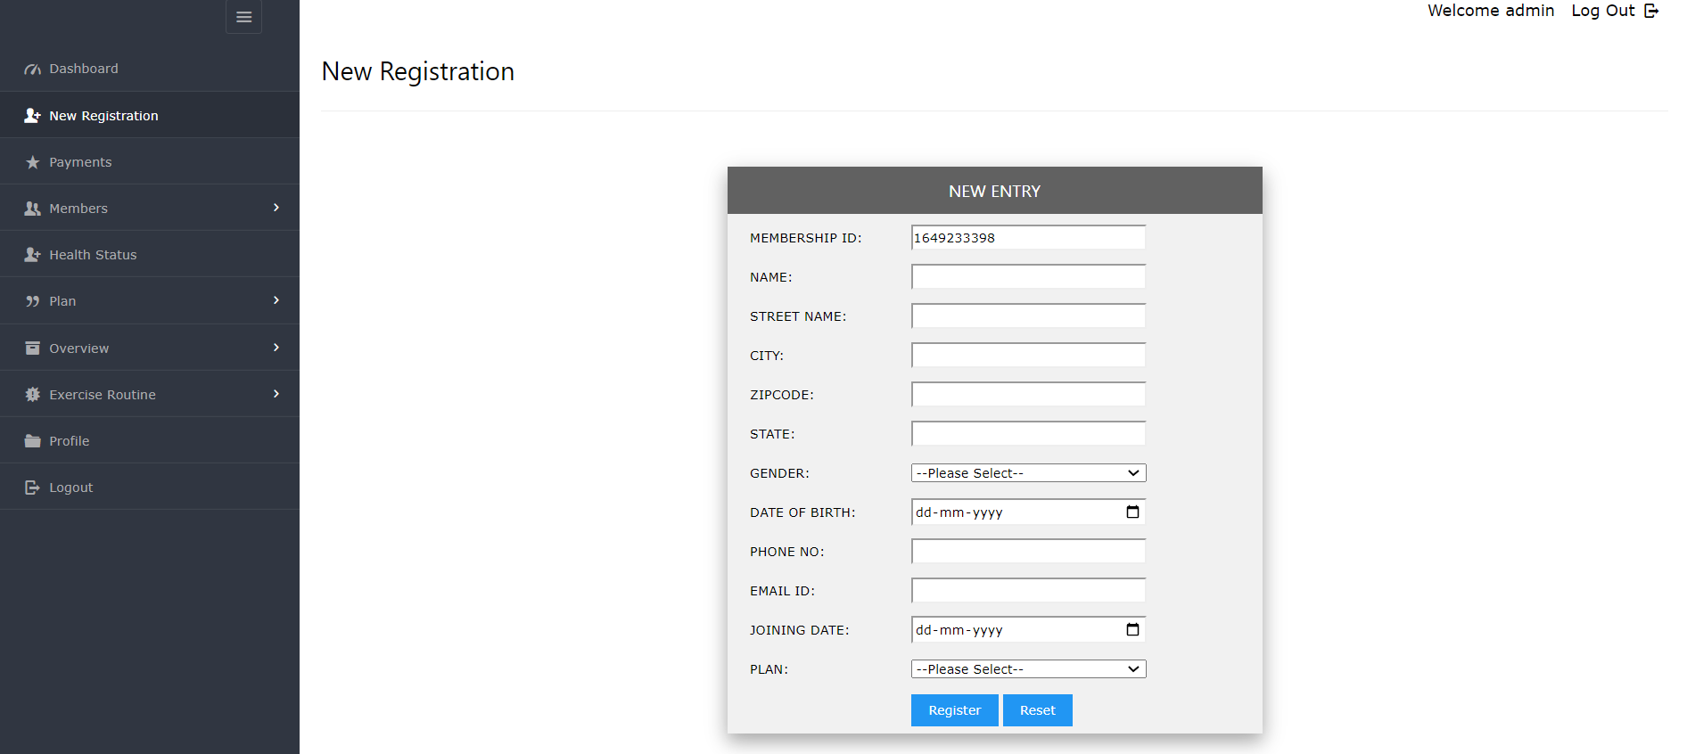
F7
Registration Page
About Us

Slide 15
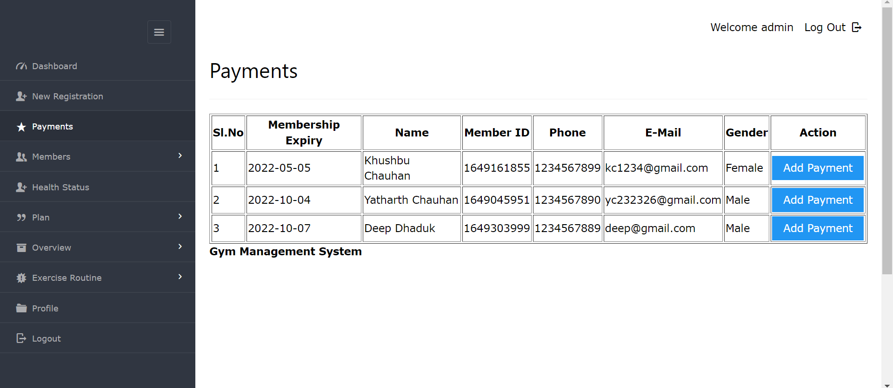
F7
Payments Page
About Us

Slide 16
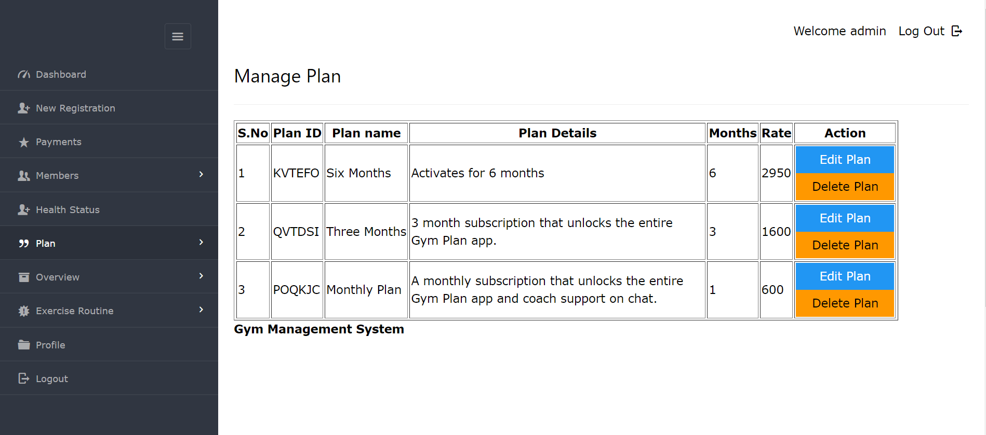
F7
Manage Plan Page
About Us

Slide 17
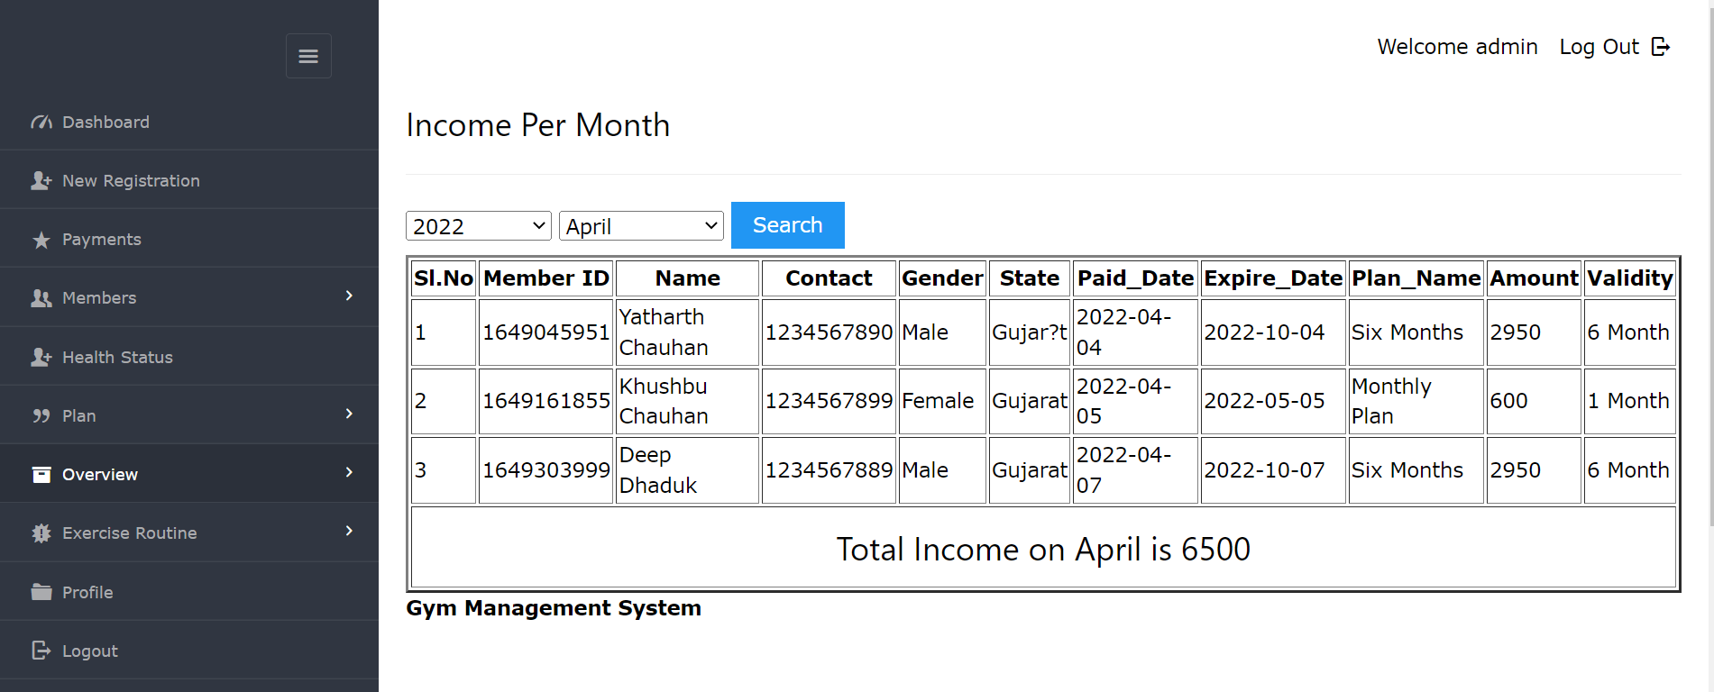
F7
Income Per Month Page
About Us

Slide 18
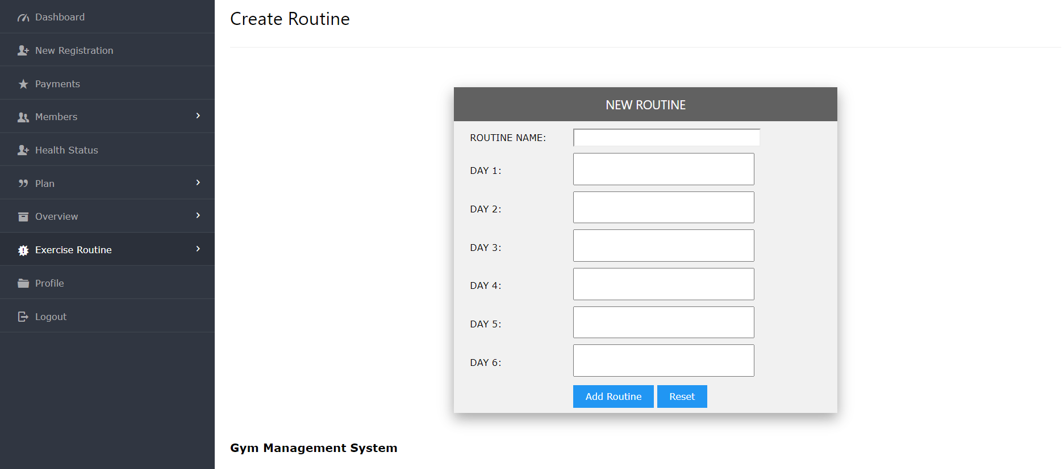
F7
Add Exercise Routine Page
About Us

Slide 19
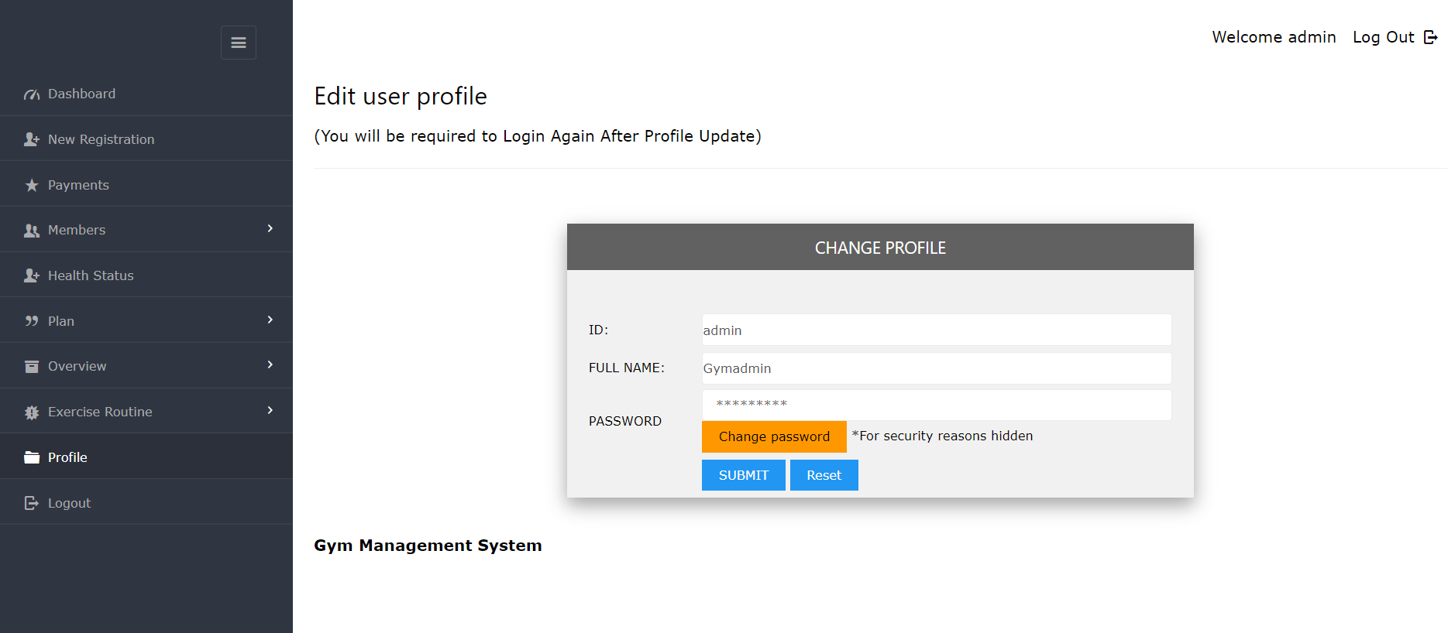
F7
Edit User Profile Page
About Us

Slide 20
F7
REFERENCES
About Us
https://www.perfectgym.com/en
https://www.gymmaster.com/
https://www.gymshim.com/
https://www.healthraja.com/gym_management/system
https://www.perfectgym.com/
https://easygymsoftware.com/
https://zenplanner.com/
https://www.pushpress.com/
https://www.mygreatness.com/

Slide 21


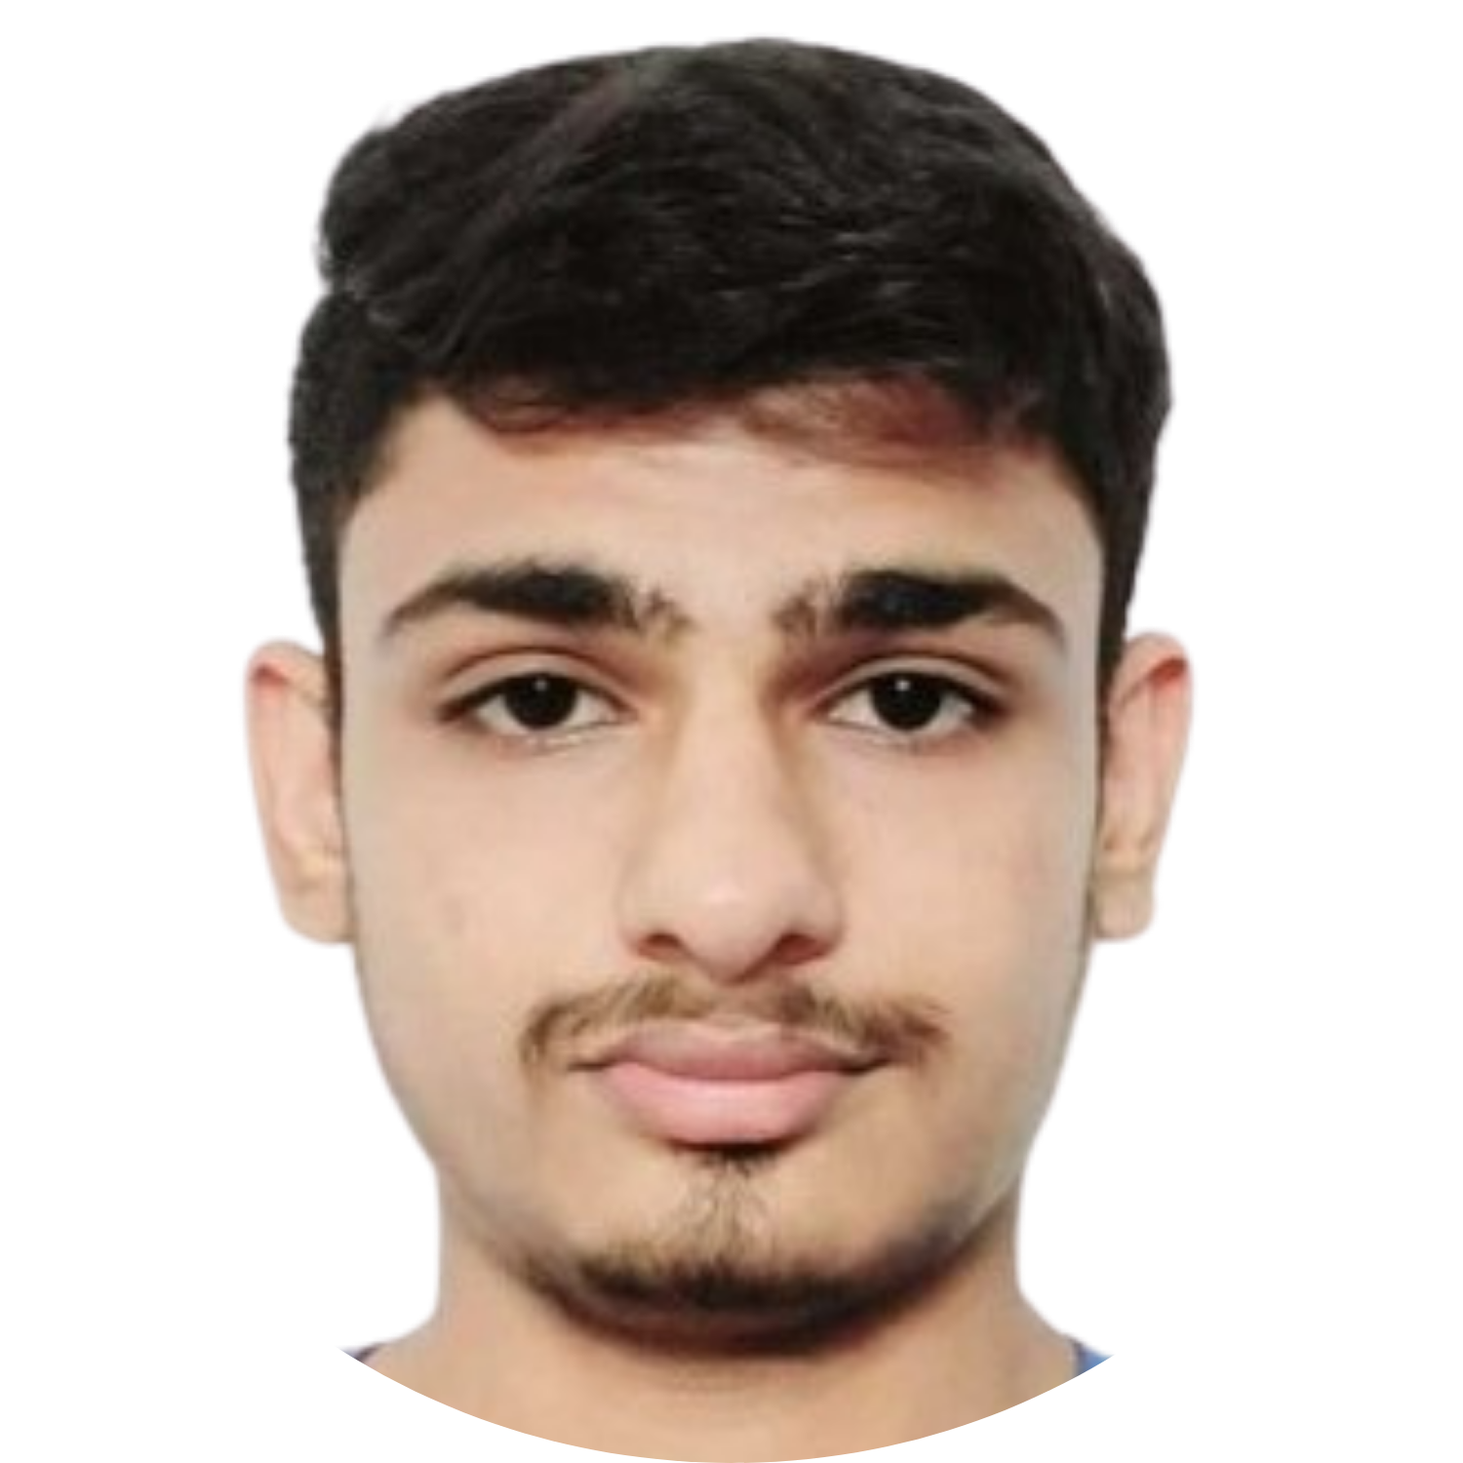
F7
TEAM PRESENTATION
About Us
YATHARTH CHAUHAN
20DCE019
KHUSHBU CHAUHAN
20DCE016
DEEP DHADUK
20DCE024

Slide 22
F7
AT THE END
About Us
THANK YOU

